Slide 1
Course Name
Newton’s laws of motion

Slide 2
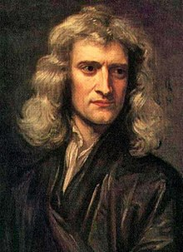
Sir Isaac Newton (1642 – 1727) was an English mathematician, astronomer, theologian, author and physicist.
He is regarded as one of the most influential scientists of all time, and a key figure in the scientific revolution.
Newton formulated the laws of motion and universal gravitation, which has dominated scientists' view of the physical universe. He worked out the “three laws of motion” governing the movement of all objects at all times and in all circumstances.

Slide 3
Newton’s 1st Law: An object at rest will stay at rest, and an object in motion will stay in motion at constant velocity, unless acted upon by an unbalanced force.
Newton’s 2nd Law: Force equals mass times acceleration.
Newton’s 3rd Law: For every action there is an equal and opposite reaction.

Slide 4
1st Law of Motion:
An object at rest will stay at rest, and an object in motion will stay in motion at constant velocity, unless acted upon by an unbalanced force.
Also known as the Law of Inertia. Inertia is the tendency of an object to resist changes in its velocity: whether in motion or motionless.
Mass (not weight) is that quantity that is solely dependent upon the inertia of an object. The more inertia that an object has, the more mass that it has.

Slide 5
1st Law of Motion:
Example: This golf ball would sit on the tee forever, unless an “unbalanced force”* acts on it. Once the golf ball is in the air after being hit, it would never stop, unless an unbalanced force acts on it again (gravity and air, fluid friction).
What is an “unbalanced force”?
When balanced forces act on an object at rest, the object will not move (if you push against a wall, the wall pushes back with an equal but opposite force so neither you nor the wall will move). Forces that cause a change in the motion of an object are called “unbalanced forces”.

Slide 6
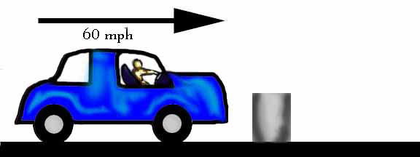
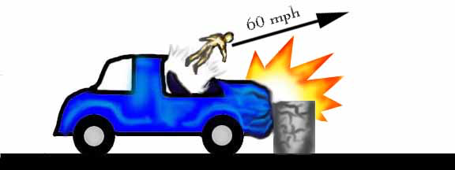
1st Law of Motion:
Example: The law of inertia says that objects (including you) resist changes in their motion. When the car moving at 60 mph is stopped by the obstacle in the road, your body keeps moving at 60 mph.

Slide 7
1st Law of Motion:
Example: A soccer ball is sitting at rest. It takes an unbalanced force of a kick to change its motion.
Example: Two teams are playing tug of war. They are both applying equal force on the rope in opposite directions. This balanced force results in no change of motion.

Slide 8
1st Law of Motion:
You would have observed that every day objects in motion slow down until they become motionless, seemingly without an outside force.
The truth is that there is a force that we sometimes cannot see (i.e. friction) that slows these objects down until they become motionless.

Slide 9
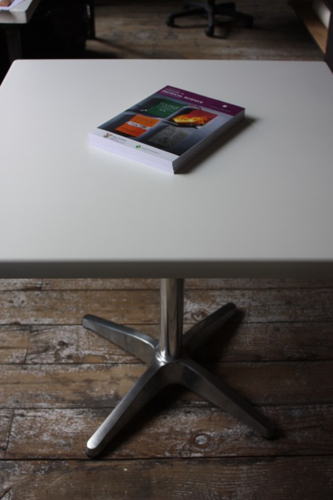
1st Law of Motion:
Example: If you were to slide a book across a table it would slide to a rest position. The book comes to a rest because of the presence of a force (i.e. friction). In the absence of a force of friction, the book would continue in motion with the same speed and direction forever (or at least to the end of the table top).

Slide 10
1st Law of Motion:
Objects on earth are under the influence of friction. This is unlike the frictionless space that the moon travels through.
The unbalanced force that acts on an object in motion is friction.

Slide 11
1st Law of Motion:
The four main types of friction:
Sliding friction: ice skating
Rolling friction: bowling
Fluid friction (air or liquid): air or water resistance
Static friction: initial friction when moving an object

Slide 12
1st Law of Motion:
To summarise:
An object will “keep doing what it was doing” unless acted on by an unbalanced force.
If the object was sitting still, it will remain stationary. If it was moving at a constant velocity, it will keep moving.
It takes force to change the motion of an object.

Slide 13
References:
https://www.slideshare.net/wilsone/newtons-laws-of-motion-1949387
https://www.slideshare.net/pvnkmrksk/newtons-laws-of-motion-2587754
https://www.grc.nasa.gov/www/k-12/airplane/newton.html
http://www.physics4kids.com/files/motion_laws.html
https://phet.colorado.edu/en/simulation/forces-and-motion-basics
https://www.youtube.com/watch?time_continue=370&v=KvPF0cQUW7s
https://www.youtube.com/watch?v=NYVMlmL0BPQ
https://www.youtube.com/watch?v=3jVHQ8bECIs
https://www.youtube.com/watch?v=Ixf9ZyZaE9Q

